Slide 1

Macathon 2016
The Marginals
Ayoub Belemlih, Ibrahima Dieye, John Mohoang, Noah Nieting

Slide 2
Outline
What is the problem? How big of a problem? How do we know?
What’s our solution and how relevant is it?
Business Model (Cost structure, revenue stream)
Potential Issues

Slide 3
First-Time Traveler
Figuring out where
Growing understanding
Challenges of Studying Abroad
Expectations & Anxieties

Slide 4
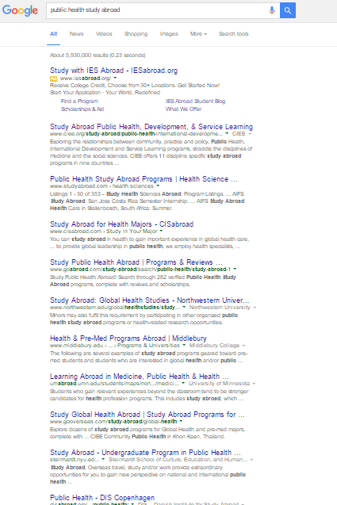
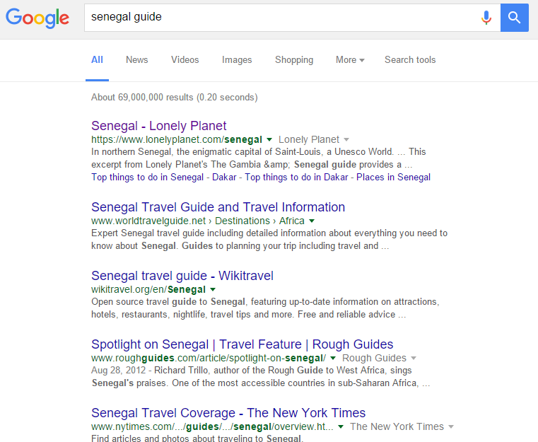
Start Your Engines

Slide 5
Search Engines, like real engines, are
NOISY

Slide 6
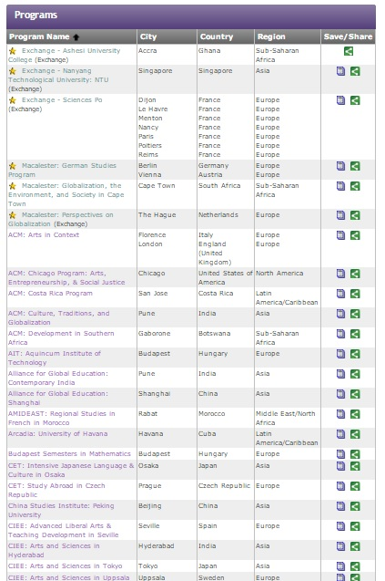
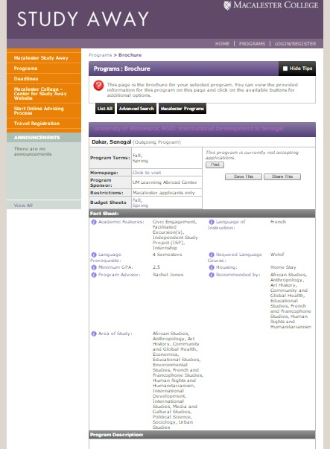
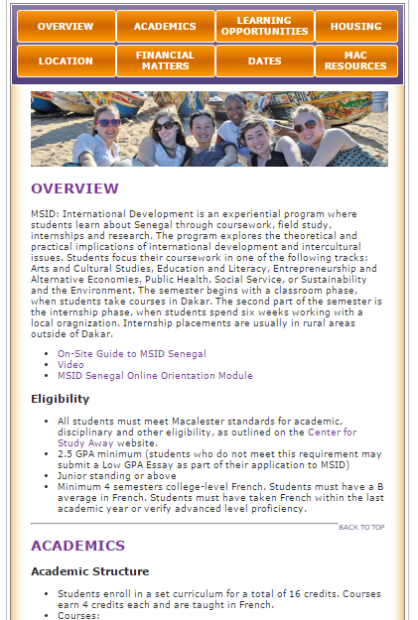
Go to School
Notes:
Student users define the rules of the game, so

Slide 7
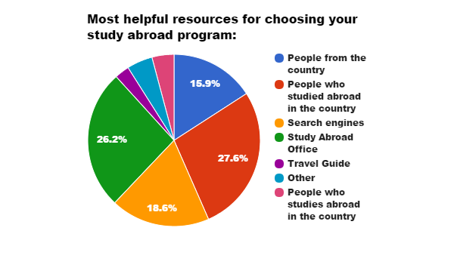
People Matter

Slide 8
What about when you know what
you’re doing?

Slide 9
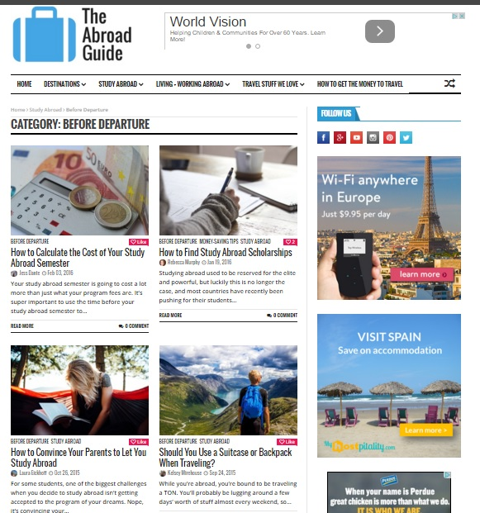
Guide for What?

Slide 10
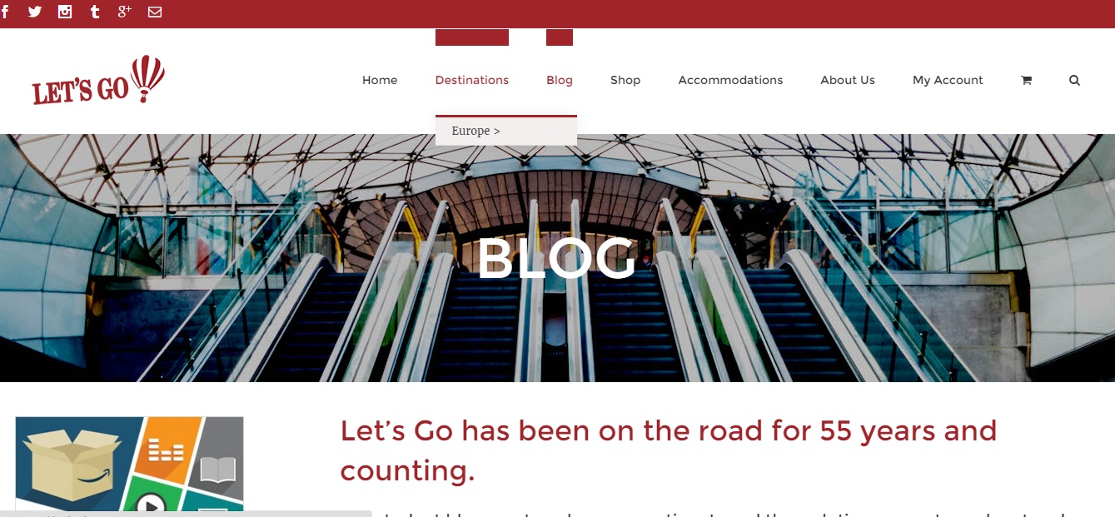
Go Where?

Slide 11
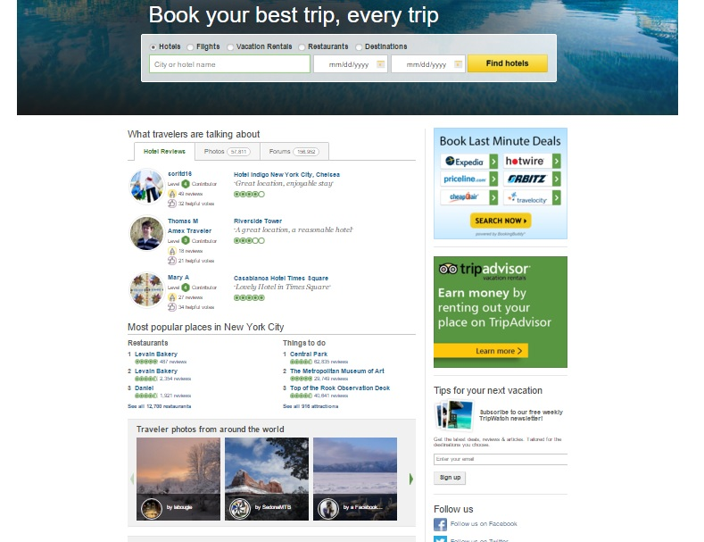
TRipping on the Details

Slide 12
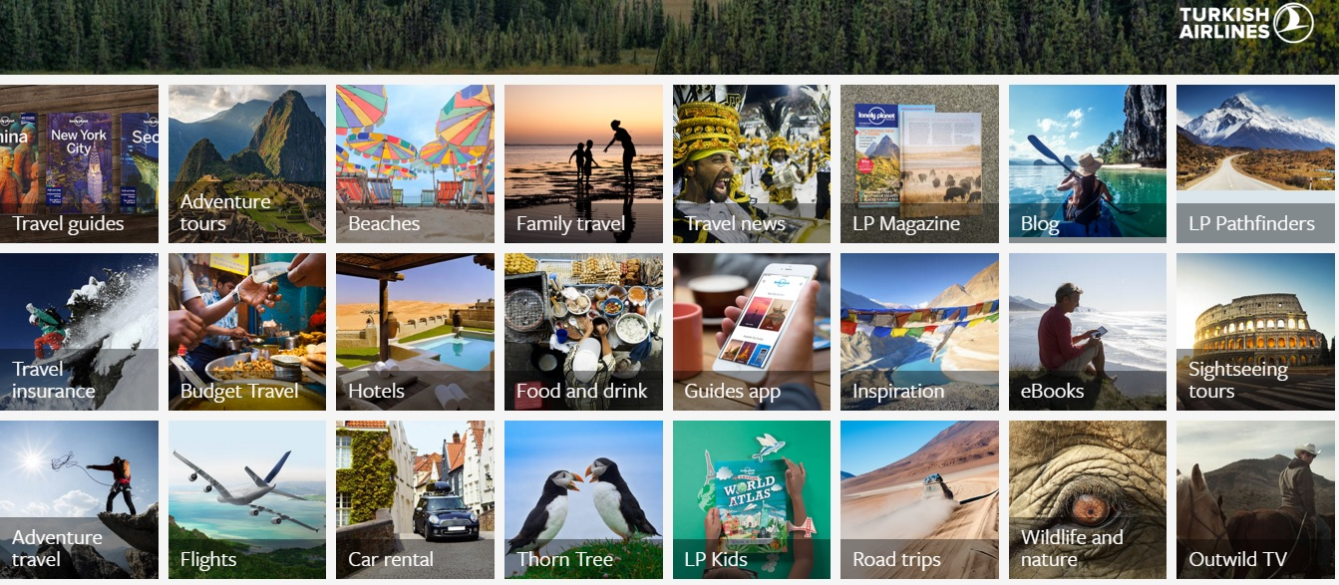
Student In Search of Students

Slide 13
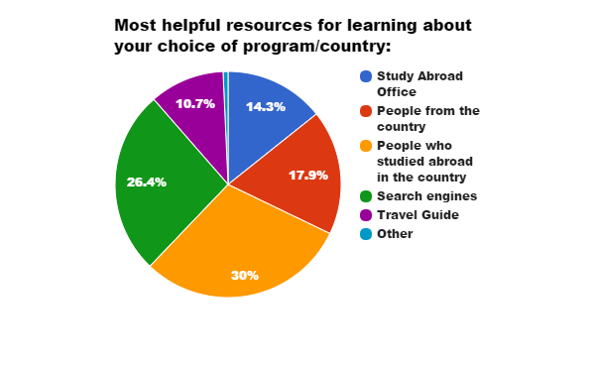
People Still Matter...

Slide 14
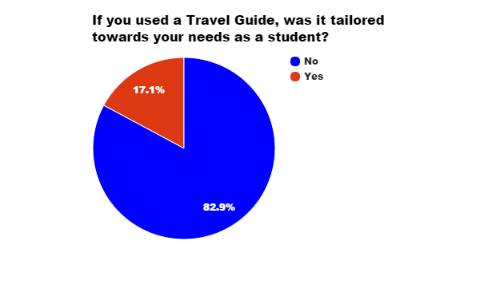
… And Travel Guides Don’t

Slide 15
The Problem
Great search resources for students, but guides fail students
Both steps ignore most valued resource: People

Slide 16
Solution = Tukki
In a one-stop site, tukki combines the search process and knowledge accumulation using the most valued resources (people) to remedy the failure of guides
A solution to the confusion and abandonment of college students, first at Mac and then across the country

Slide 17
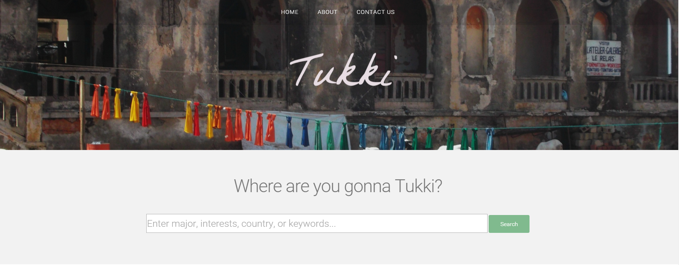
Prototype overview: Homepage
Notes:
Background Picture is Noah’s from Senegal
We will potentially add some other functionalities: more pictures, relevant articles...

Slide 18
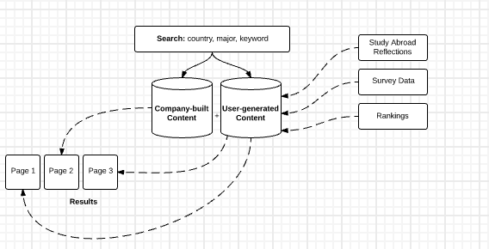
Search bar implementation

Slide 19
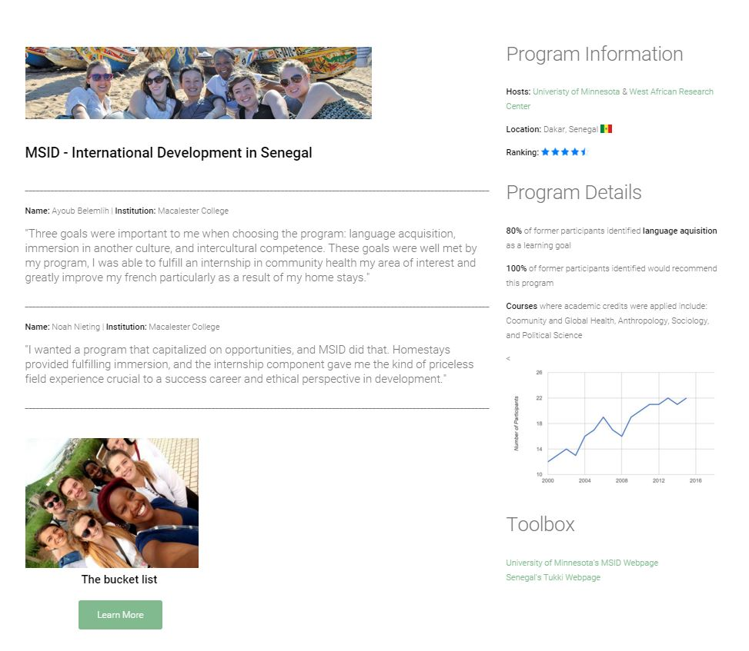
example country page

Slide 20
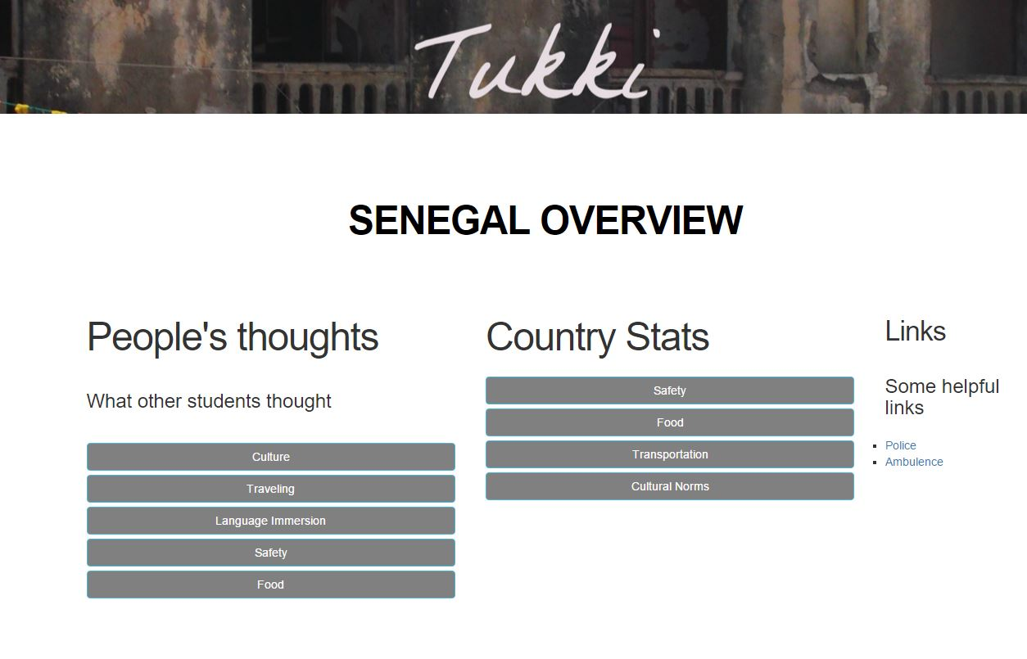
Example program page

Slide 21
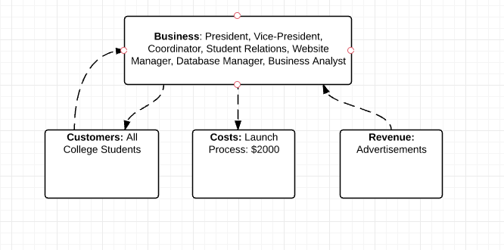
Potential Business Model

Slide 22
Potential Issues
User-generated content: sustaining participation
Marketing our idea

Slide 23
the bigger picture: Advantages
For Students, By Students
A wide ranges of students from diverse institutions
Combines People & Searches engines, can be integrated into Study Abroad Offices

Slide 24
Questions, concerns, suggestions, outrage...

Slide 25
Macathon 2016
The Marginals
Ayoub Belemlih, Ibrahima Dieye, John Mohoang, Noah Nieting

